Slide 1




BRACT’s Vishwakarma Institute of Information Technology, Pune Department of Artificial Intelligence and Data Science Viz-A-Thon 3.0 in Collaboration with
Team Details
Team Members
Team Id | 24
Team Name | Echelon
Team Leader | Manglesh Nimbalkar
College Name | Vishwakarma Institute of Information Technology
No. Of team Members | 4
Problem ID | 1
Name | Mobile | Email Id
Manglesh Nimbalkar | 9156974101 | manglesh.22210095@viit.ac.in
Rutvik Kachgunde | 7276799914 | rutvik.22210148@viit.ac.in
Pranav Kolhe | 7058830820 | pranav.22320080@viit.ac.in
Jayant Patil | 8261961156 | jayant.22210045@viit.ac.in

Slide 2
Index
Title/Problem statement.
Output screenshots.
Conclusion in bulleted form.
LinkedIn handle.
Skills Used, Learning and Tools Functionalities used.

Slide 3
Title/Problem statement
The dataset contains detailed traffic information, including source, destination, distance, time, traffic level, time of day, day of the week, number of trips, and date for various routes in Pune.

Slide 4
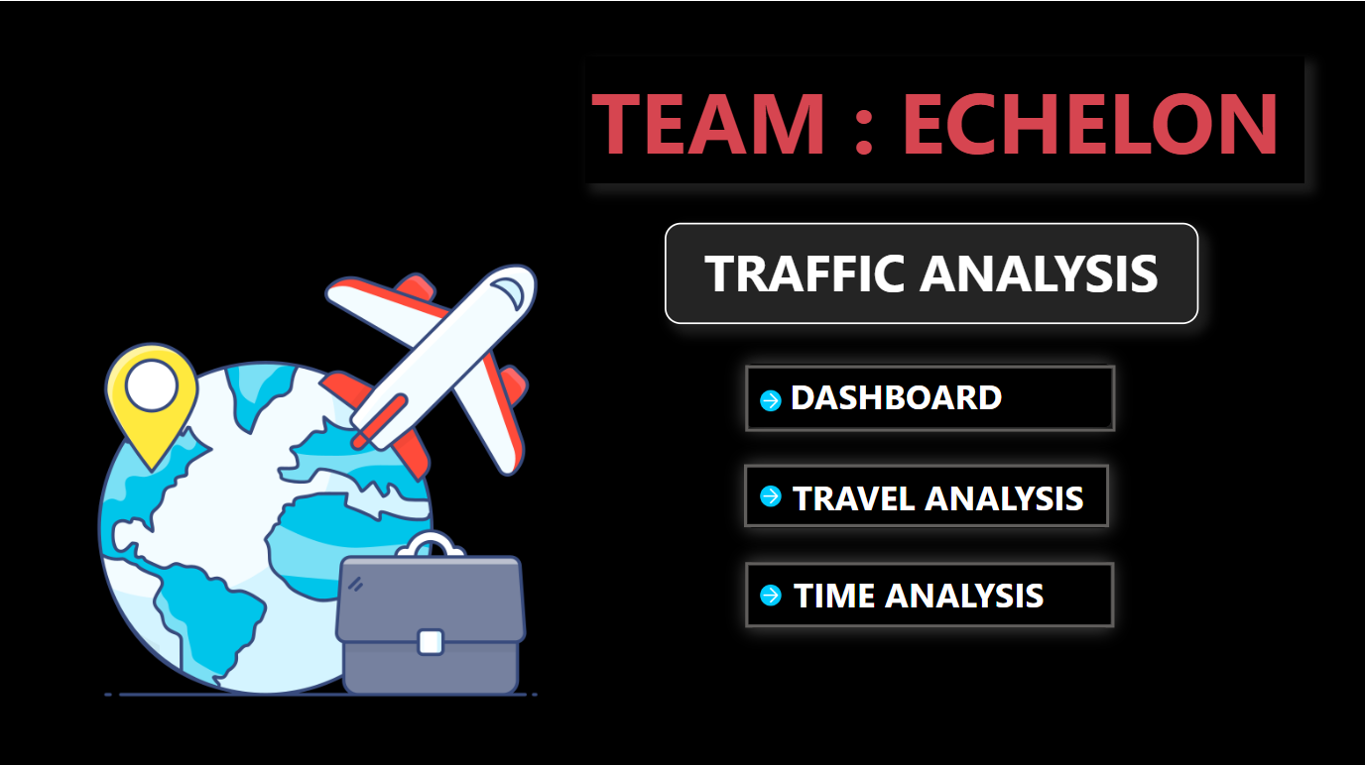
Output Screenshots

Slide 5
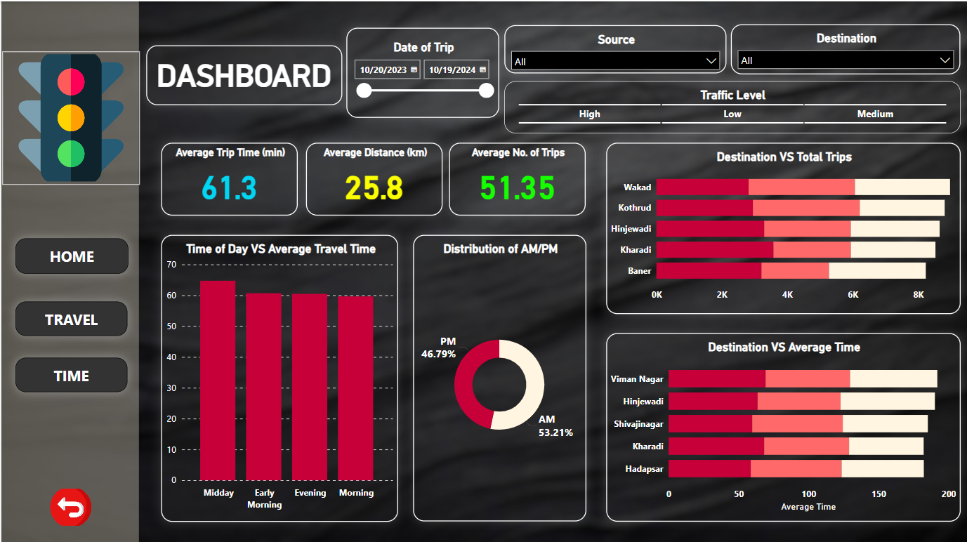
Output Screenshots

Slide 6
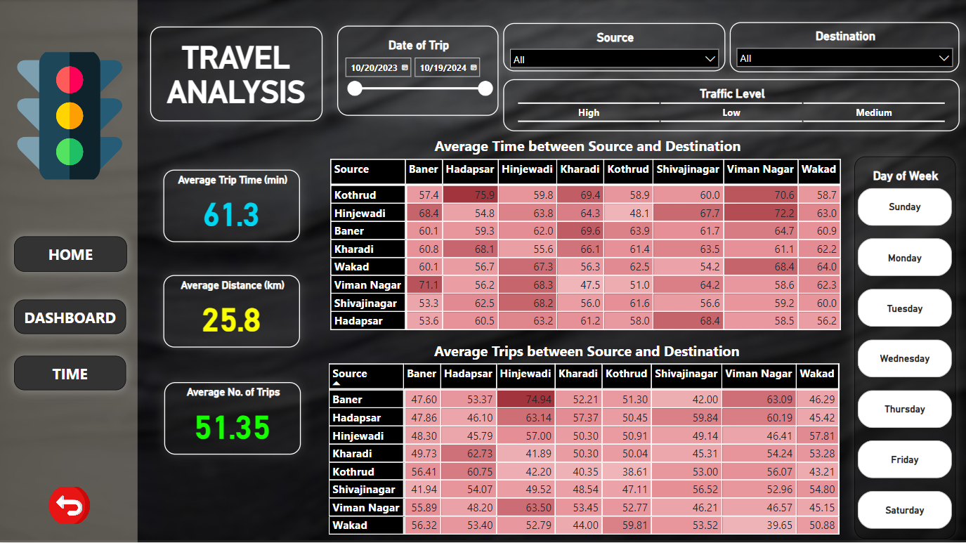
Output Screenshots

Slide 7
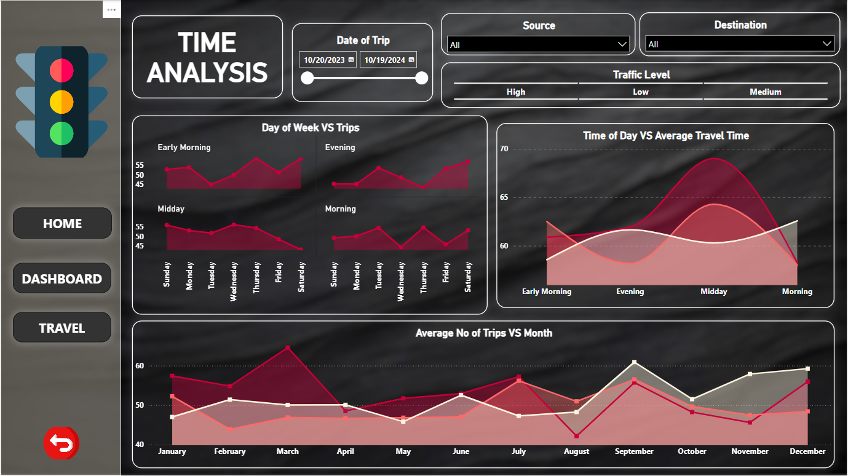
Output Screenshots

Slide 8
Conclusion
What is the most preferred destination in Pune?
Conclusion – The most preferred destination in Pune is Wakad.
2. Which destinations in Pune require the most average time to reach?
Conclusion – The top 3 destinations which require the most average time to reach are Viman Nagar, Hinjewadi, and Shivaji Nagar.
3. How should traffic be managed in Pune based on average travel times during different times of the day?
Conclusion – Pune has most traffic during midday and early morning durations so these are the peak durations where we require most of the traffic police force.
4. When do people mostly travel in Pune (AM or PM)?
Conclusion – Nearly 53 % of the total trips take place during AM and remaining during PM. Thus people mostly travel during AM.
5. What is the average number of trips made from each source to each destination in Pune?
Conclusion – There are nearly 51 trips made from each source to each destination in Pune.

Slide 9
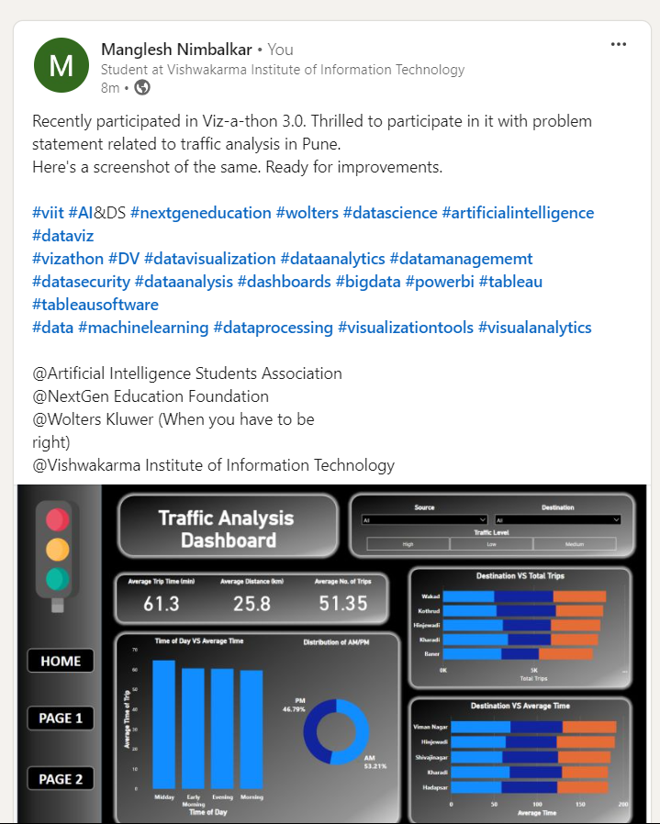
LinkedIn Post Link
LinkedIn Post

Slide 10
Skills Used, Learning and Tools Functionalities used
Power BI
Data Analysis
Inference and Conclusion Derivation
Data Science

